Slide 2
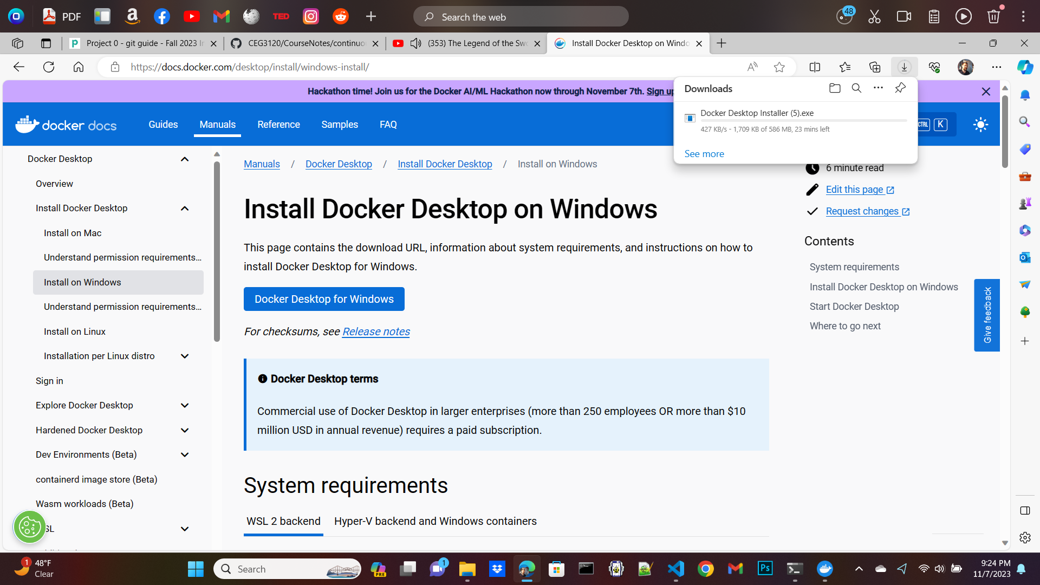
how to install docker + dependencies

Slide 3
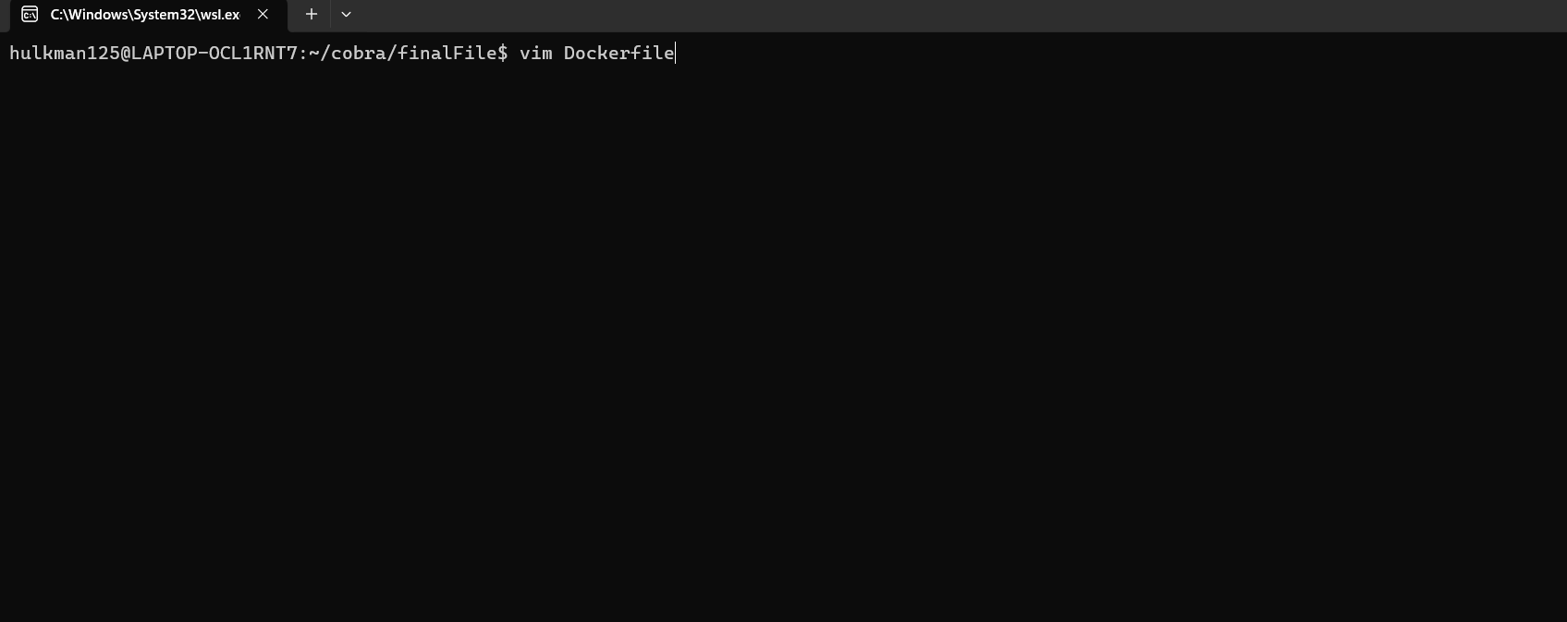
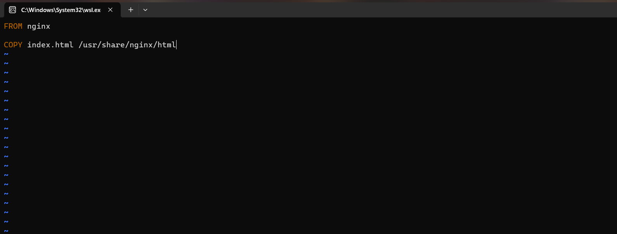
how to build an image from the Dockerfile

Slide 4
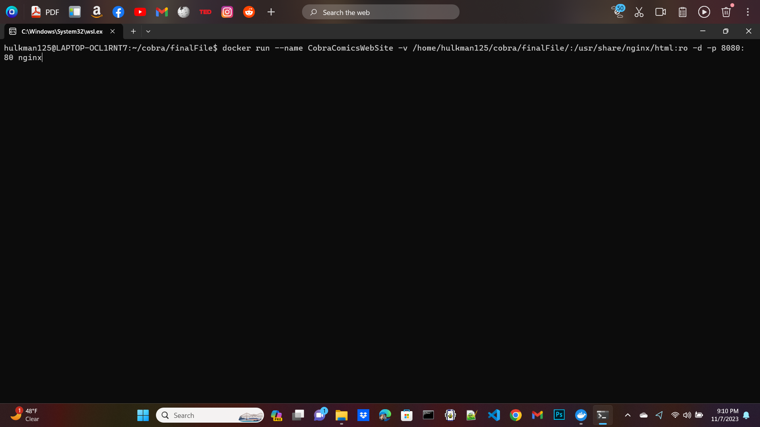
how to run the container

Slide 5
how to view the project running in the container
Simply go to the URL and type down “localhost:8080”

Slide 6
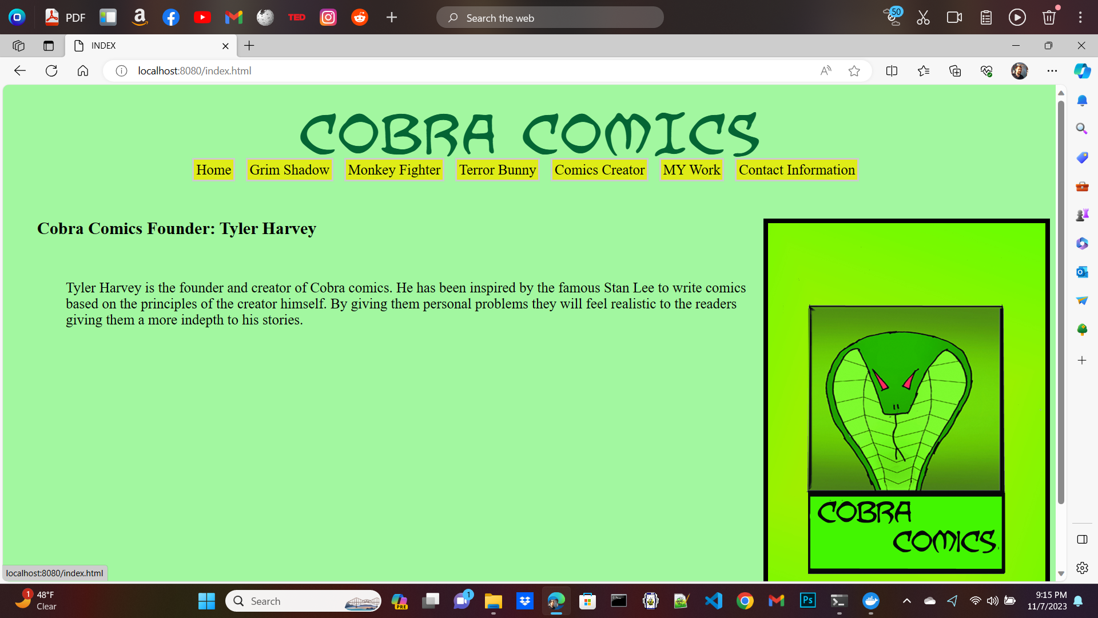
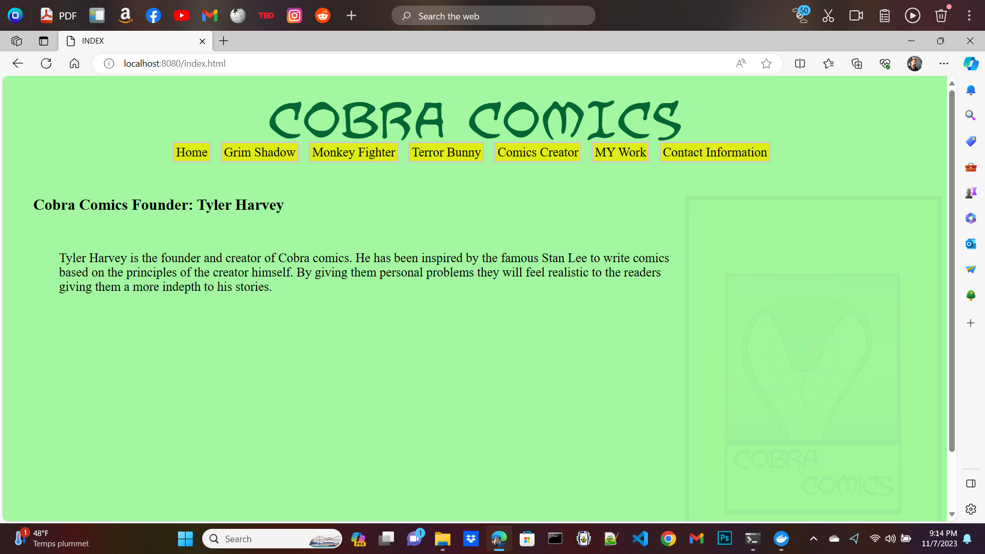
Examples of my docker work(this includes javascript)
Before Fading
After Fading

Slide 7
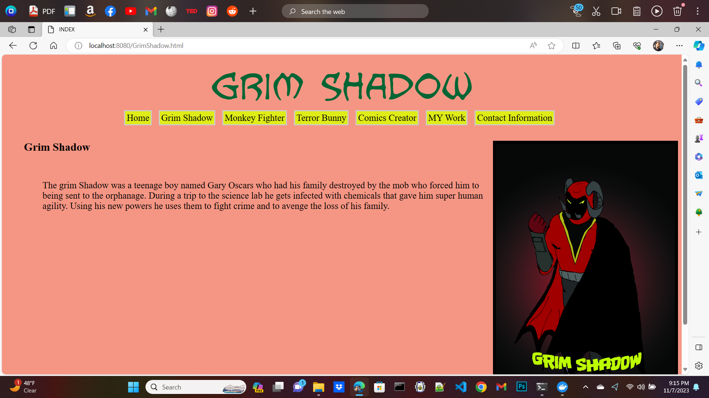
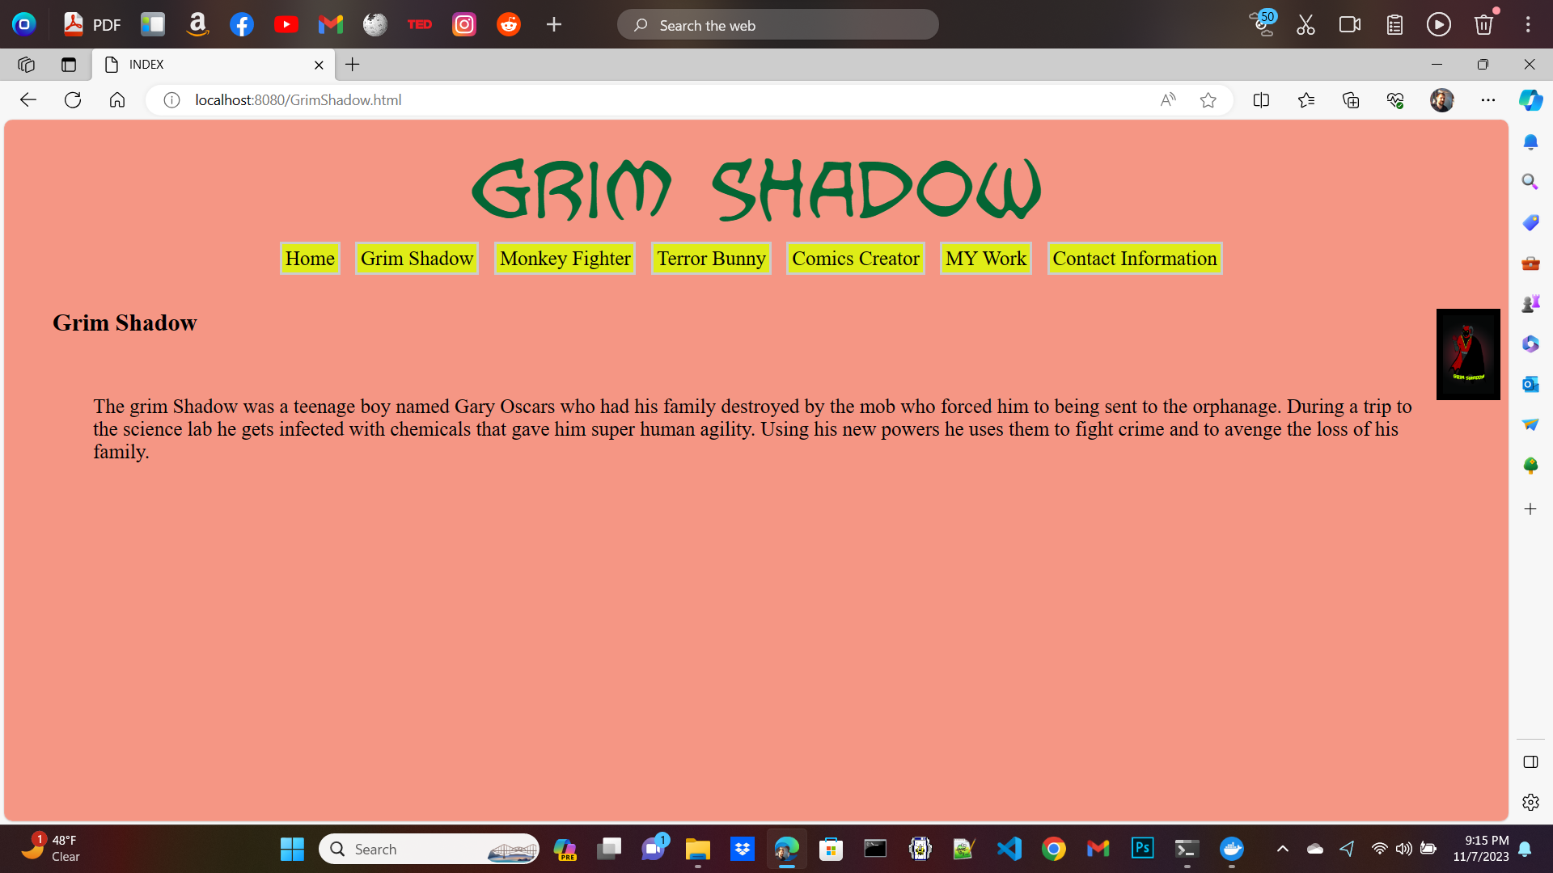
Examples of my docker work(this includes javascript)
Before resizing
After resizing

Slide 8
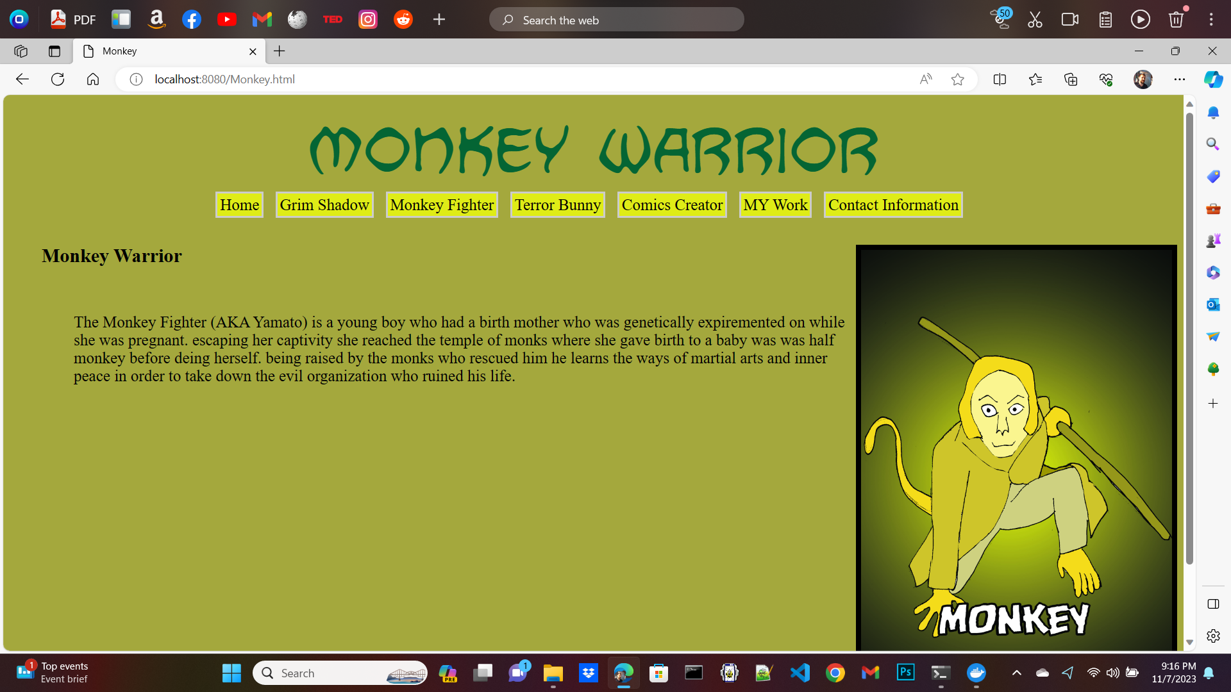
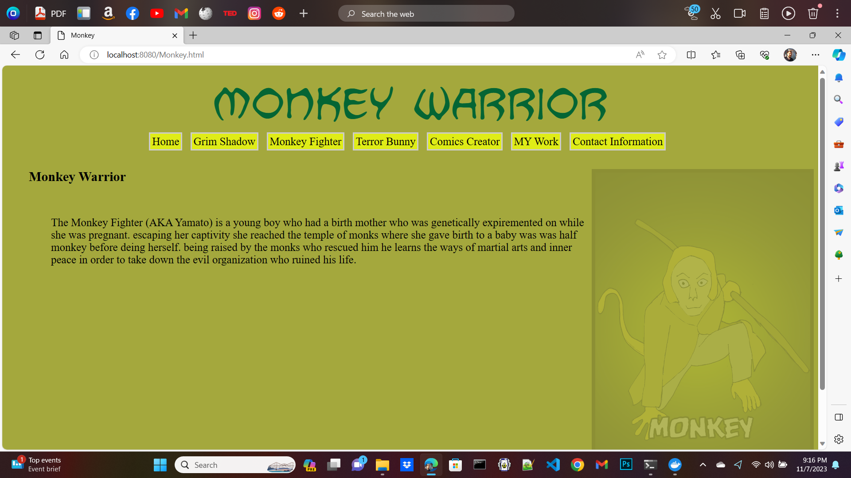
Examples of my docker work(this includes javascript)
Before fading
After fading

Slide 9
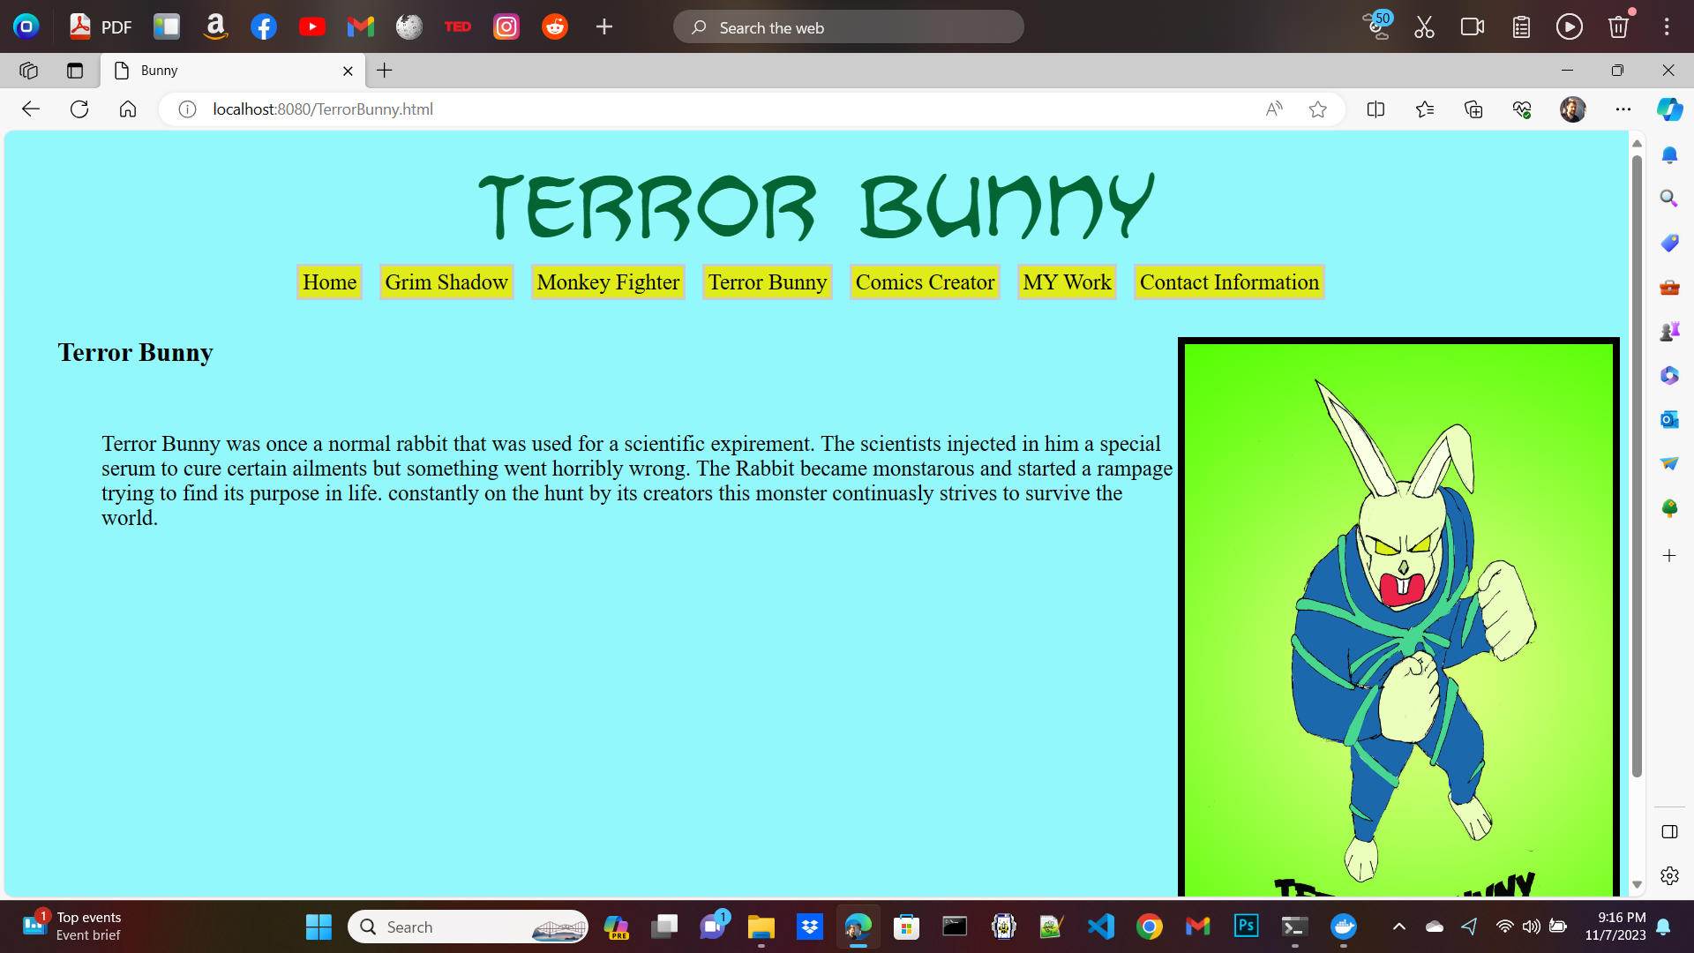
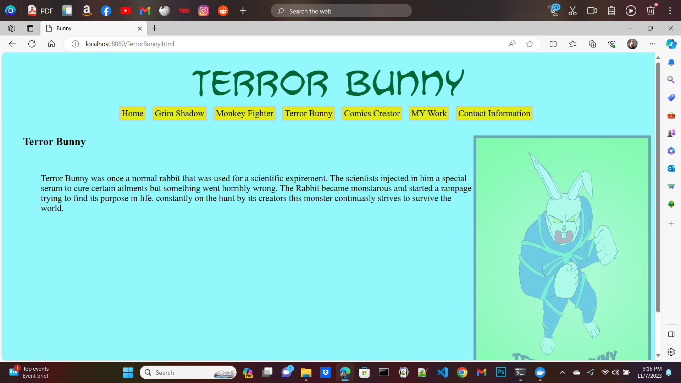
Examples of my docker work(this includes javascript)
Before fading
After fading

Slide 10
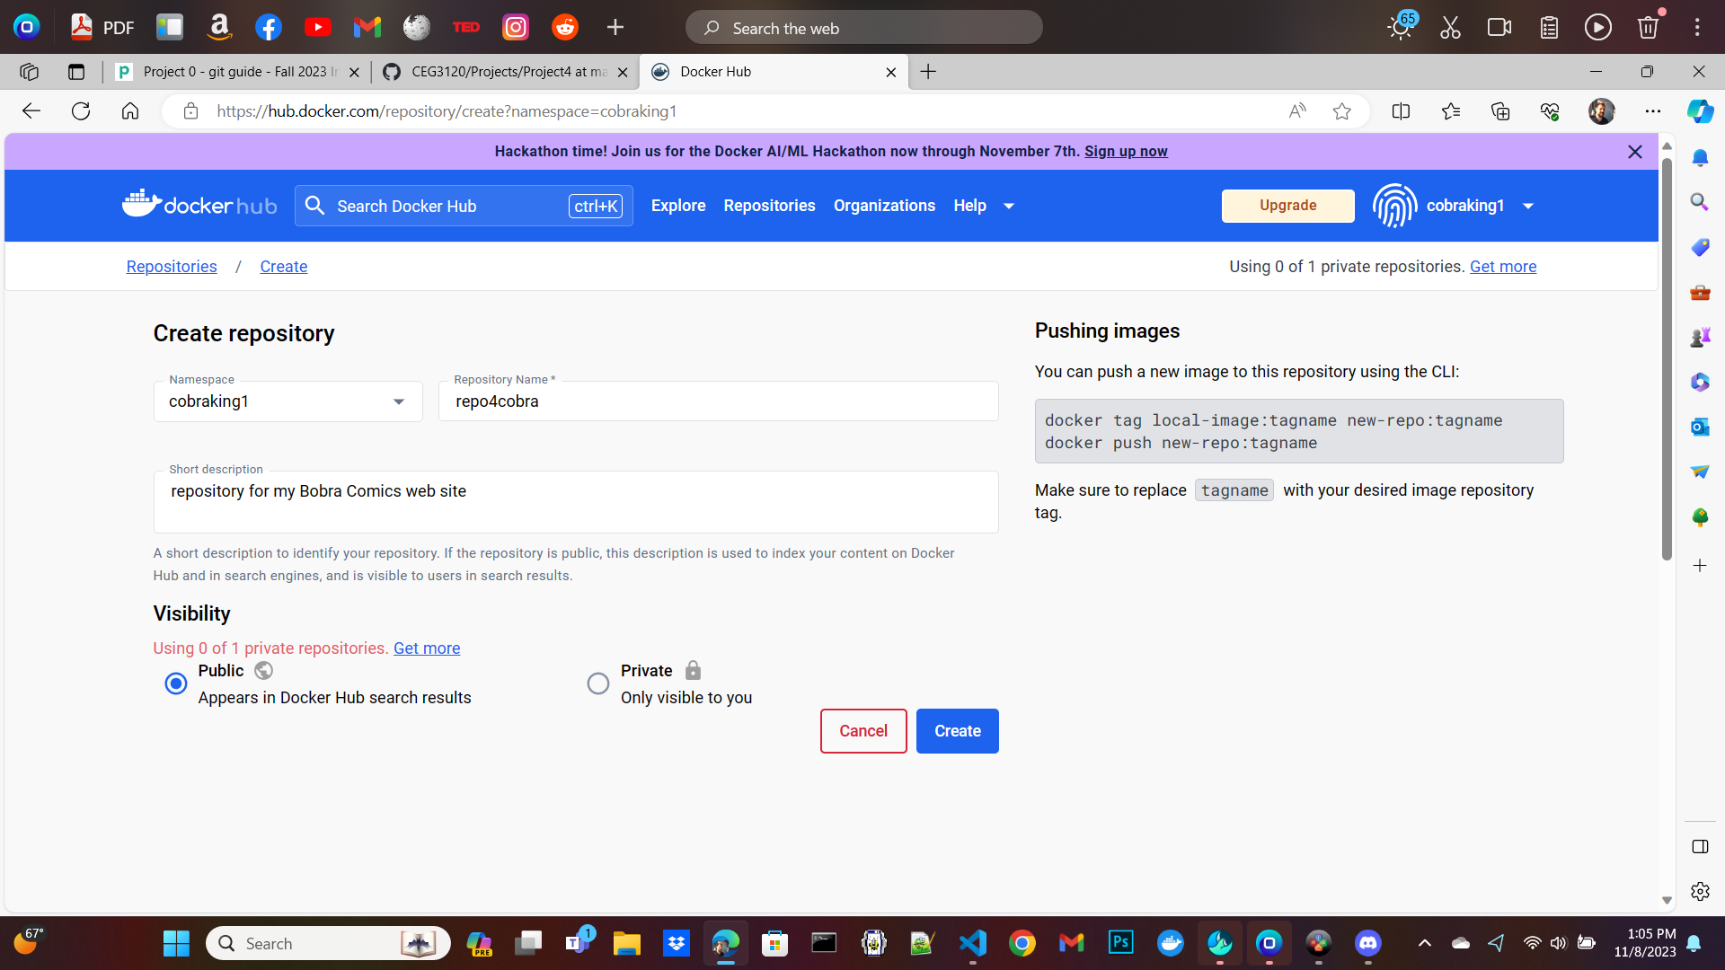
Process to create public repo in DockerHub
Just click on the “create repository button”.

Slide 11
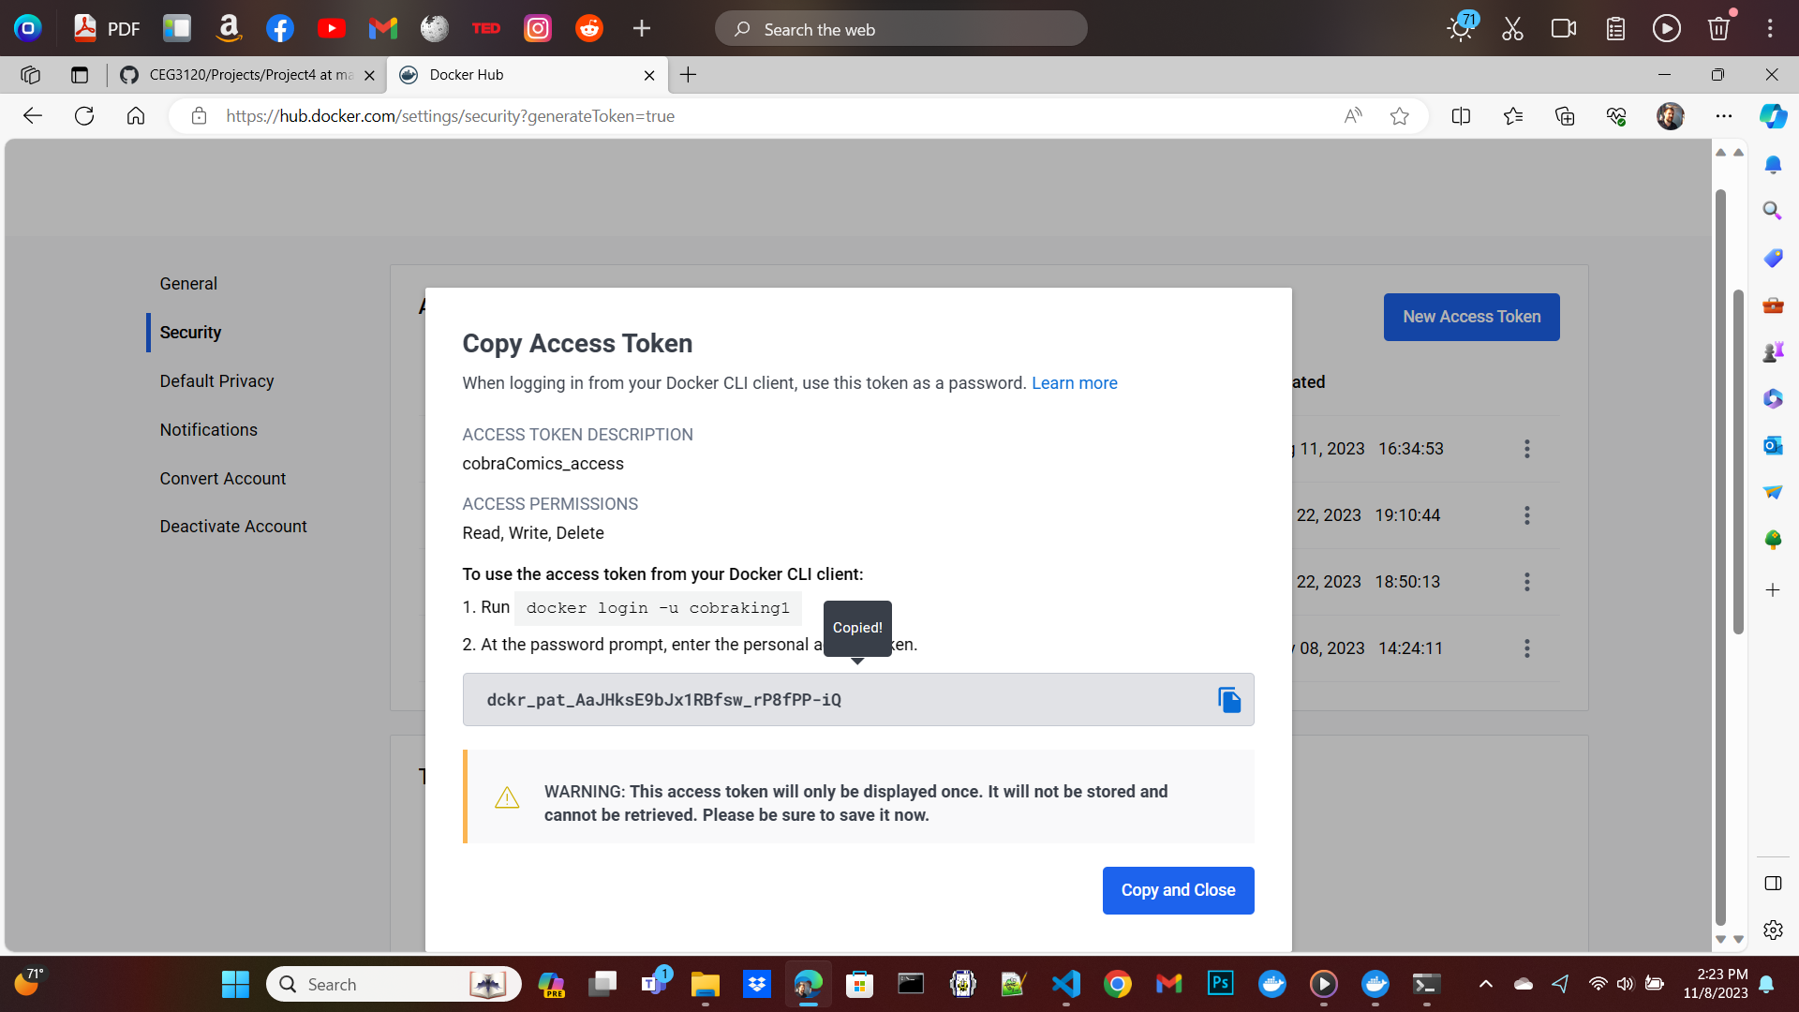
Creating an access token

Slide 12
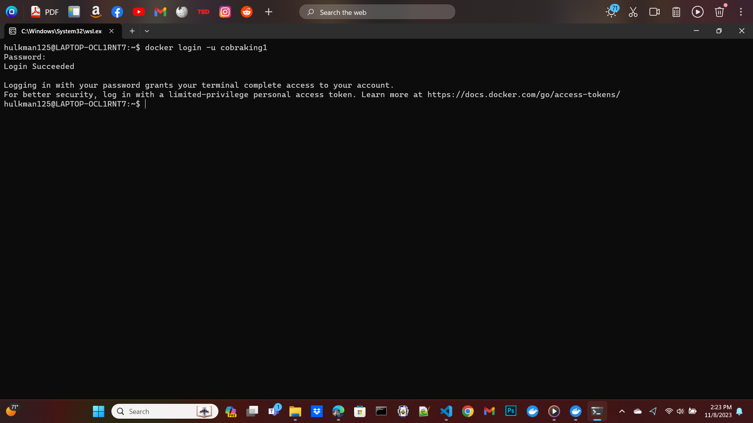
Login to docker using your given passcode

Slide 13
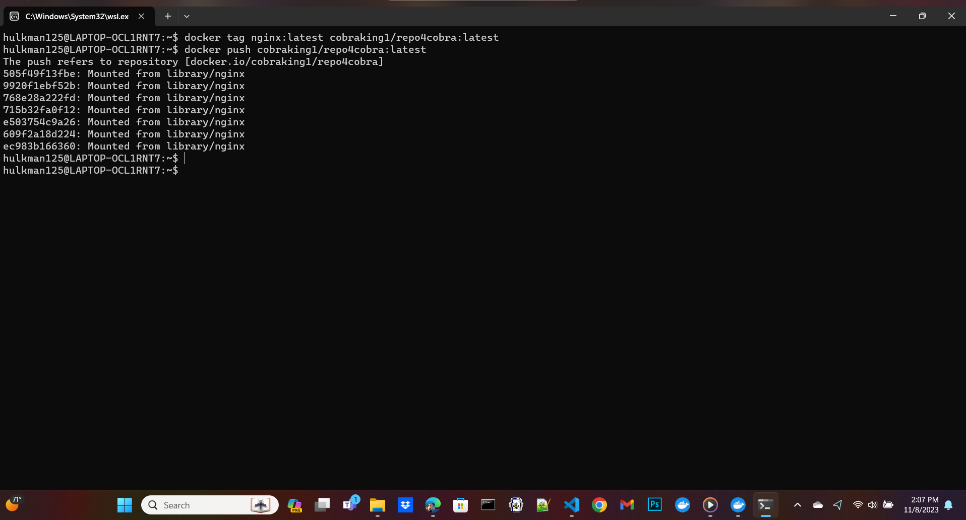
used the latest nginx image

Slide 14
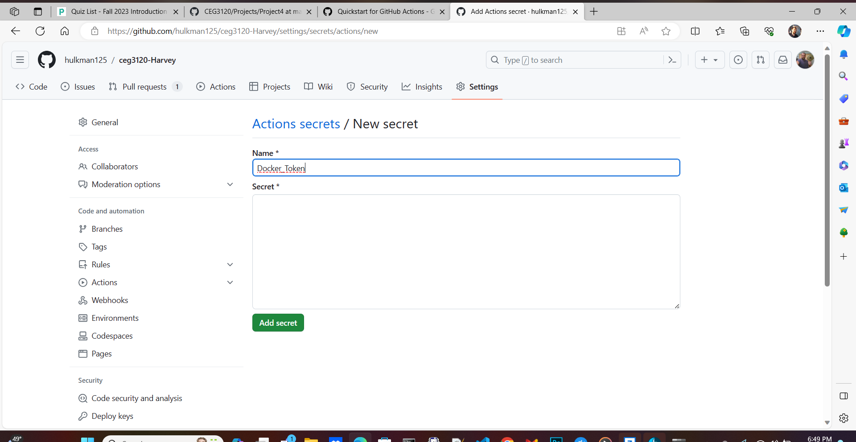
Action secrets: Docker Token

Slide 15
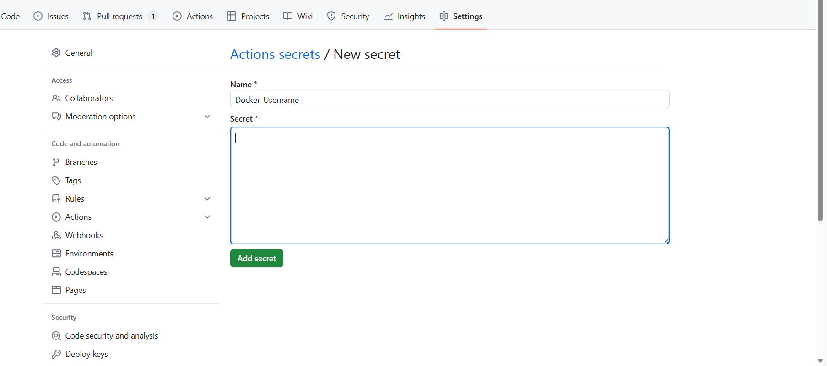
Access secrets: Docker Username

Slide 16
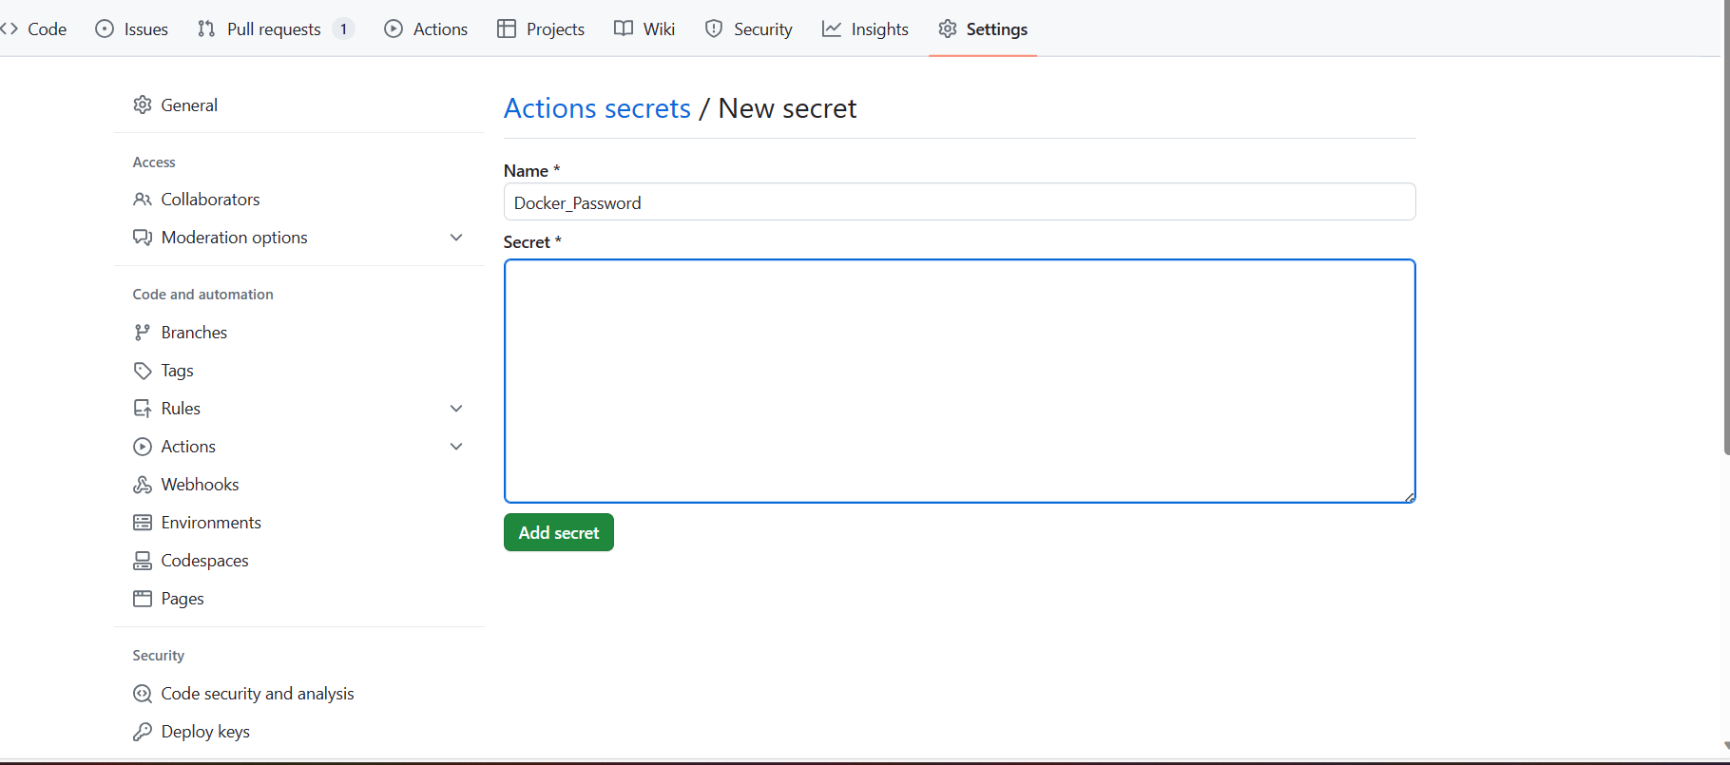
Access secrets: Docker Password

Slide 17
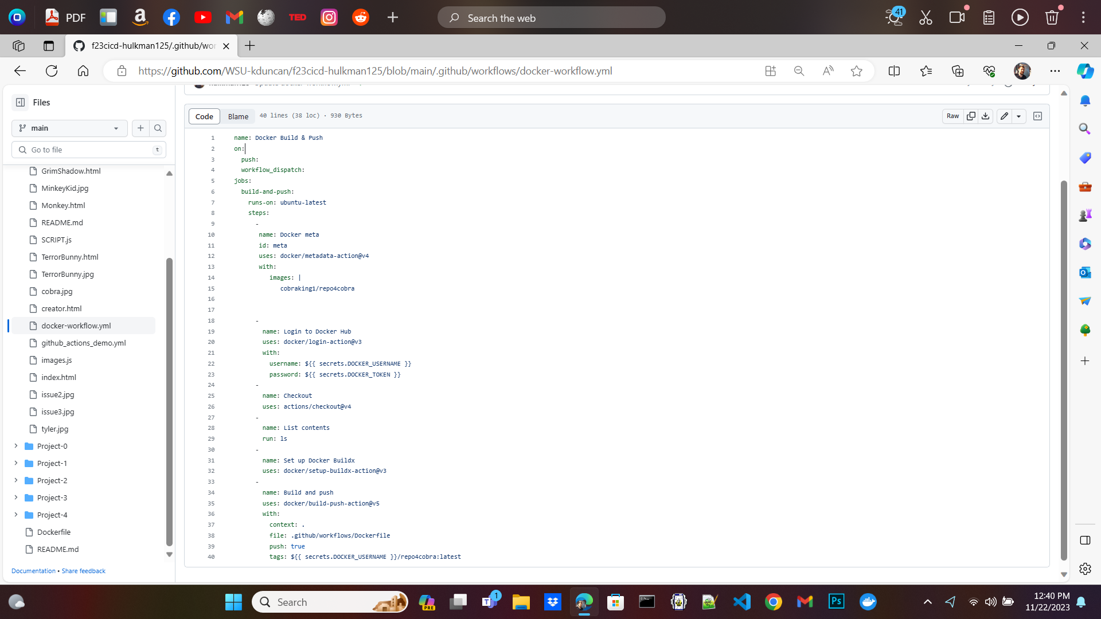
workflow

Slide 18
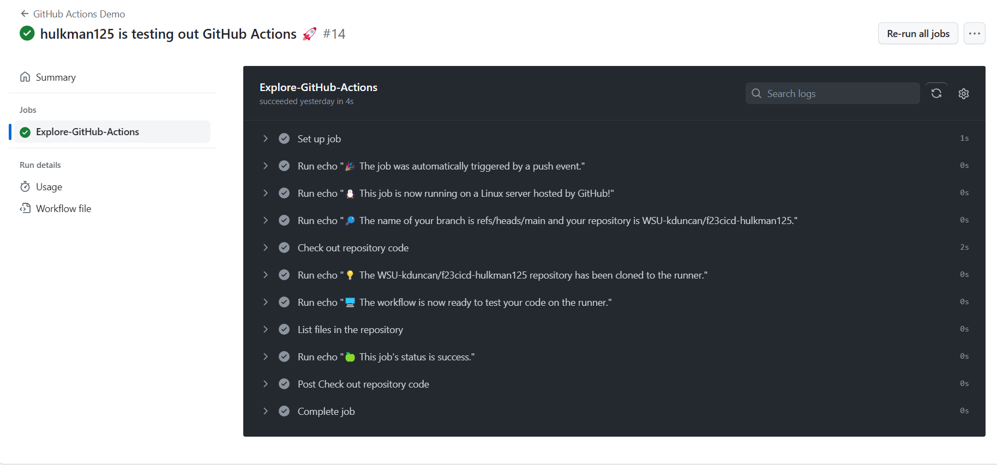
Workflow in the actions tab

Slide 19
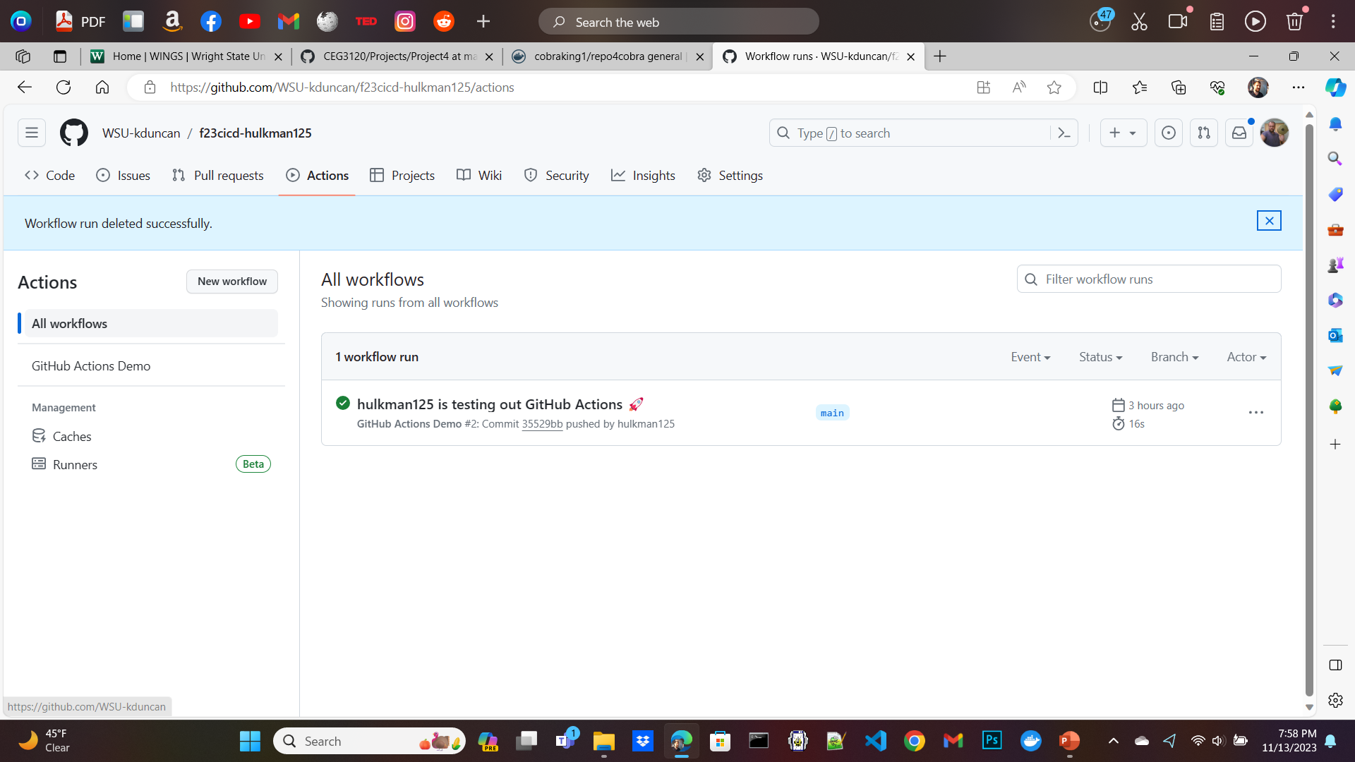
Github actions

